Slide 1
Multibreed evaluations: Strategies for use in the Girolando breed
John B. Cole, PhD
3rd International Girolando Congress | November 14, 2025

Slide 2
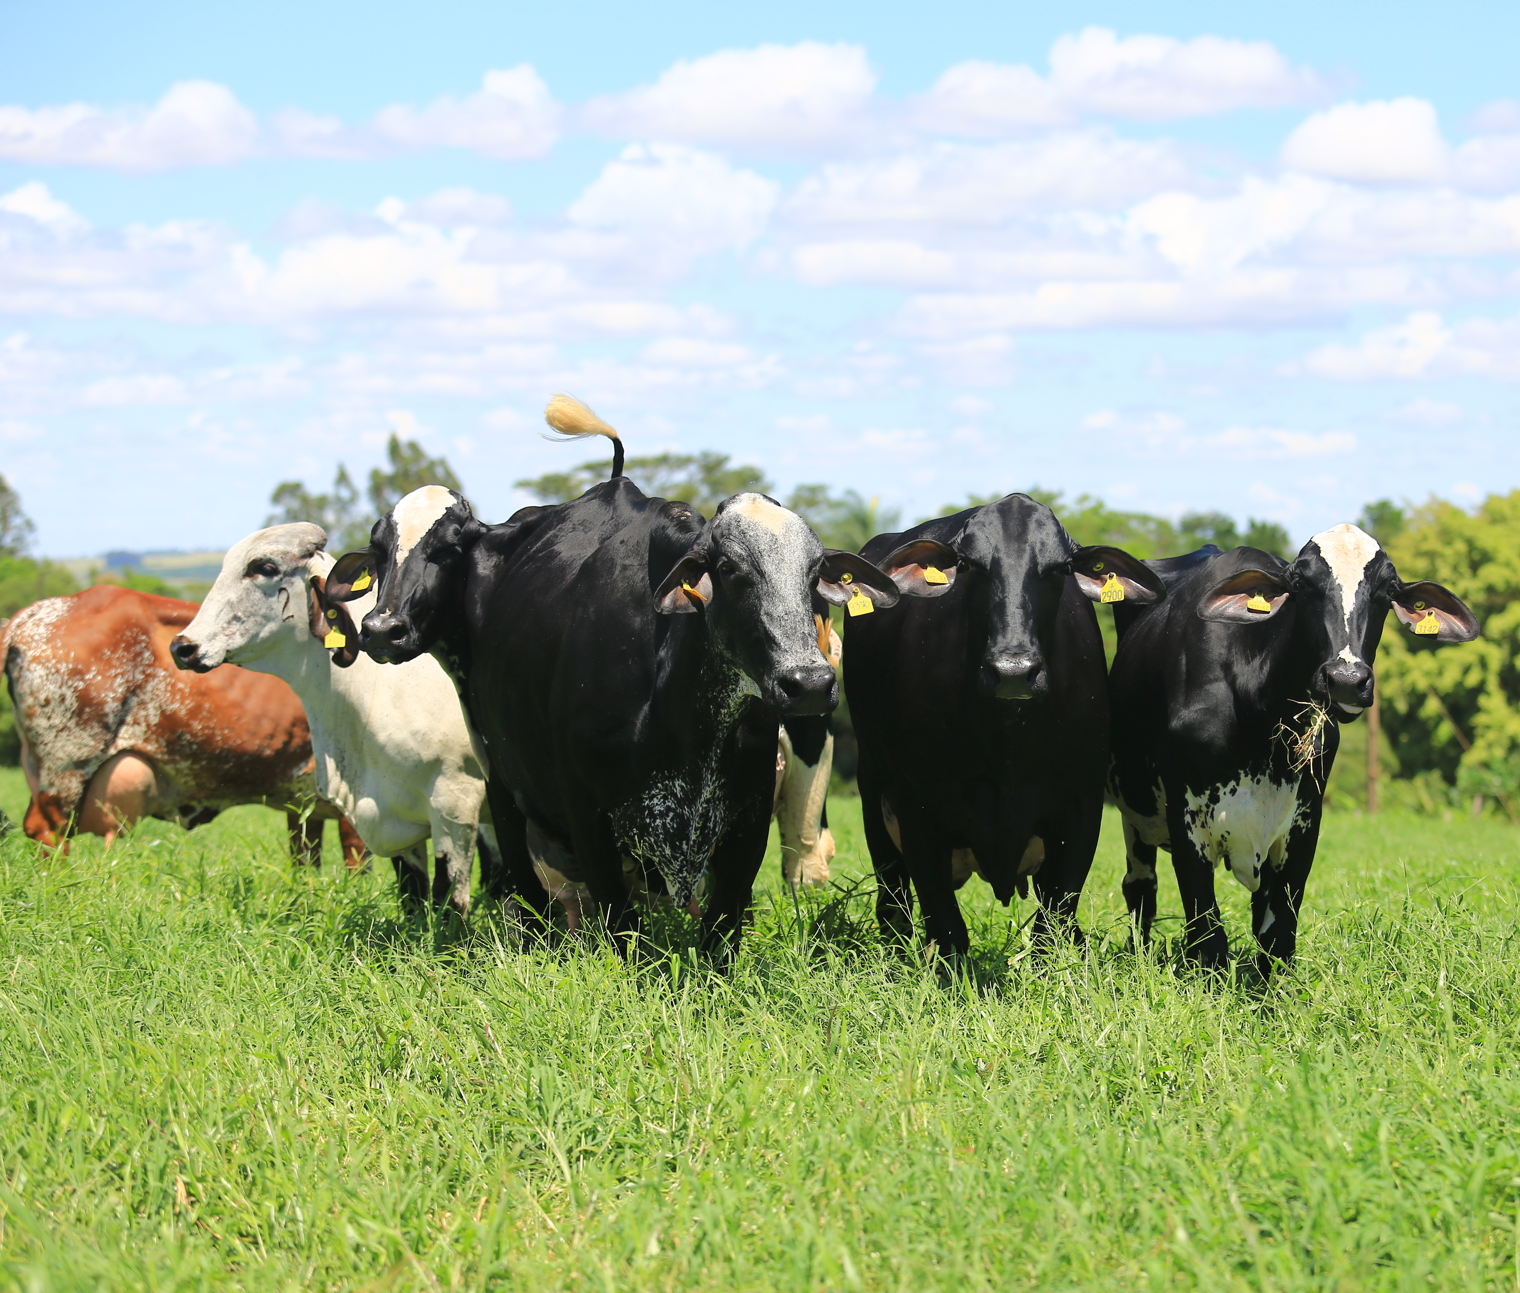
Topics
How does genetic improvement work?
How are multi-breed and single-breed populations different?
Possibilities for the Girolando breed
Photo courtesy of Dr. Marcos Vinicius Barbosa da Silva.

Slide 3
How does genetic improvement work?

Slide 4









Milk, fat, protein, pedigree, genotypes
Milk Samples
Cow Data
Individual PTA
Calculation of genetic evaluations

Slide 5
What influences traits of interest?
Phenotype = Genotype + Management + Environment
Variation attributable to genetics varies:
Female fertility: 0.04
Working life: 0.08
Udder health: 0.12
Milk production: 0.35
Variation due to management practices is large:
Feeding
Housing
Reproductive management
Variation from environmental factors can be important:
Weather (short-term)
Climate (long-term)
Notes:
5
5

Slide 6

What influences genetic progress?
ΔG = genetic gain each year
reliability = our certainty about an animal’s predicted genetic merit (genomics ⬆)
selection intensity = how selective we are when picking mates (management can ⬆)
genetic variance = genetic variation in the population (we can’t really change this)
generation interval = time between generations (genomics ⬇)

Slide 8
How are multi-breed and single-breed populations different?

Slide 9
Benefits of purebred programs
Rates of genetic gains are high
Offspring are more uniform (mating outcomes are more predictable)
Often accompanied by loss of genetic diversity
You must have pure breeds to use crossbreeding!

Slide 10
Benefits of crossbreeding programs
Can combine desirable features of two different breeds
  Example: Milk of Holsteins with heat tolerance of Gir
Heterosis from combining complementary traits
Works best when breeds have similar genetic levels
“Crossbreds may not exceed the best purebred for any single trait, yet the net economic merit of crossbreds may be superior to purebreds when all traits affecting or influencing net income are considered” (McDowell, 1982)
Van Eenennaam (2019; https://beef-cattle.extension.org/crossbreeding-for-the-commercial-beef-producer/)

Slide 11
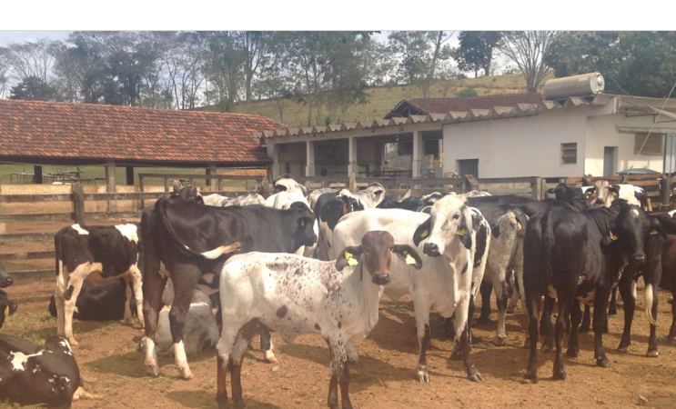
Girolando cattle on a farm near Coronel Pacheco, MG, Brasil (photo taken by author).

Slide 12

Pure breeding vs. crossbreeding
Purebred Mating
Crossbred Mating
+50
+30
+50
+30
+40
+60
Value of mating:
50 + 0 (no heterosis) = 50
Value of mating:
50 + 10 (20% heterosis) = 60

Slide 13
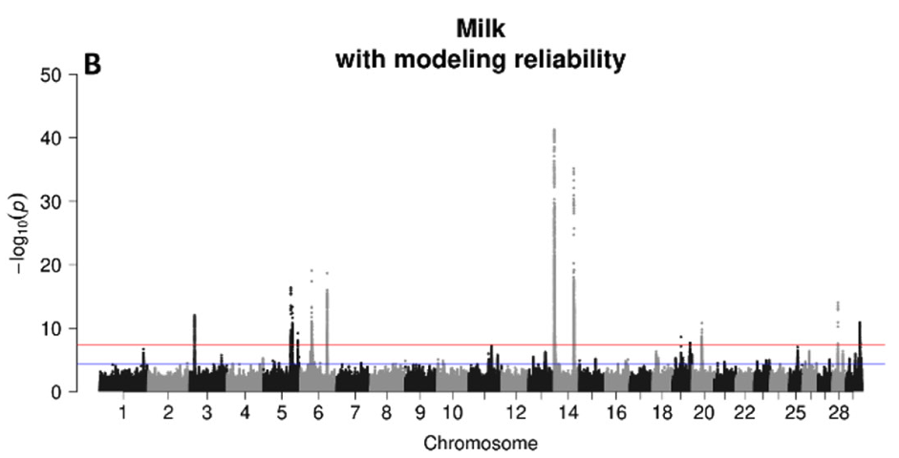
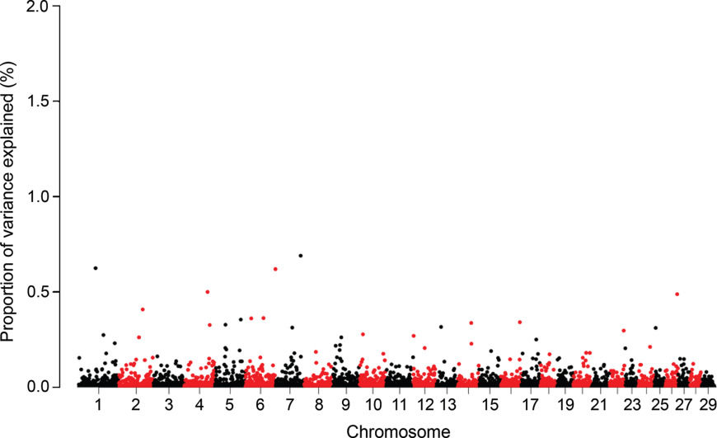
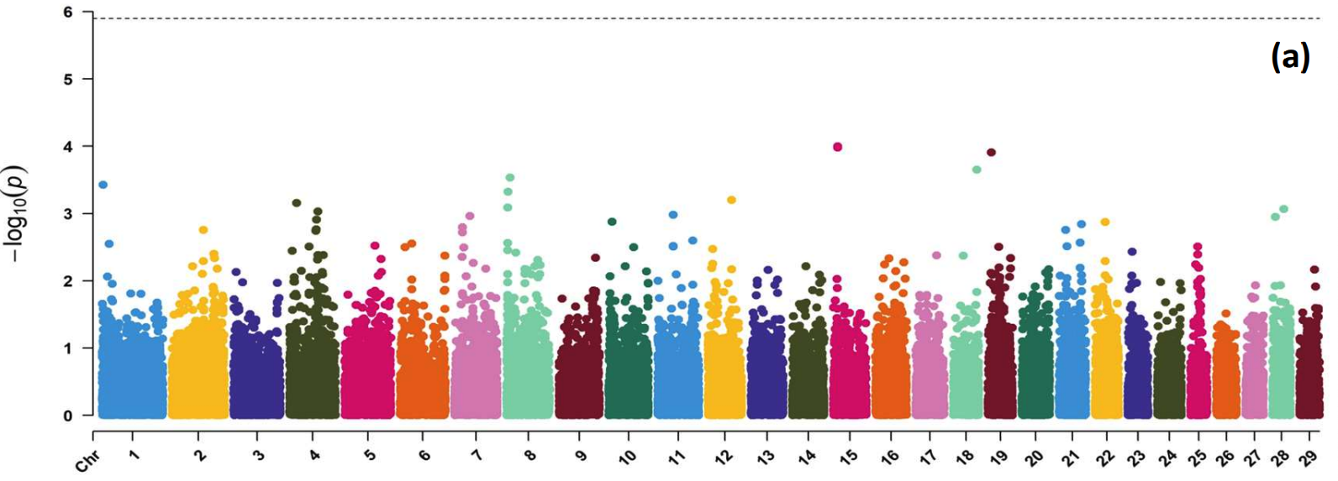
Causal variants differ across breeds
US Holsteins
Girolando
Brazilian Gir
Otto et al. (2020; https://doi.org/10.3168/jds.2019-17890), Dominguez-Castaño et al. (2024; https://doi.org/10.3168/jds.2024-24648), Wang et al. (2025; https://doi.org/10.3168/jds.2025-27058)

Slide 14
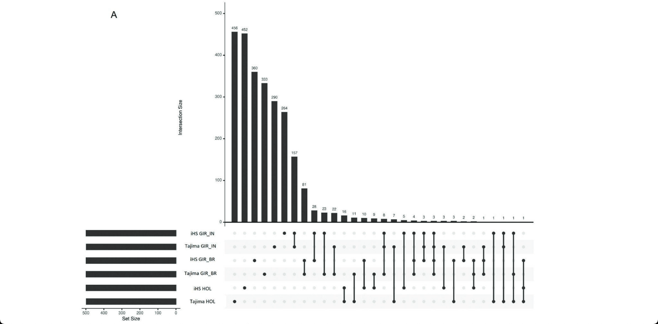
Regions under selection differ by breed
Indian Gir
Brazilian Gir
Canadian and US Holstein
Braga et al. (2025; https://doi.org/10.3168/jds.2024-26147)

Slide 15
Possibilities for the Girolando breed

Slide 16
How do we make a Girolando?
Gir
Holstein
½ Gir : ½ Holstein
Gir
5/8 Gir : 3/8 Holstein
1/4 Gir : 3/4 Holstein
Holstein

Slide 17
Benefits and limitations of this cross
Benefits
Maintains maximum amount of heterosis (e.g., Vieira et al., 2022)
Continuous introduction of new genetic variation
Limitations
The cross is “unstable” – it can’t be easily maintained at 5/8 Gir:3/8 Holstein
Genetic evaluations require very complex mathematics
The Gir and Holstein populations don’t have pedigree connections

Slide 18
But then what?
5/8 Gir : 3/8 Holstein
Gir
Holstein
5/8 Gir : 3/8 Holstein
13/16 Gir : 3/16 Holstein
5/16 Gir : 11/16 Holstein
5/8 Gir : 3/8 Holstein

Slide 19
What if the herdbook is closed?
Girolando is now a synthetic breed
Only animals with parents in the herdbook can be registered
Heterosis erodes over time
Genetic evaluations are much easier to compute
Girolando bull
Girolando cow
Girolando cow
Girolando bull
Etc.

Slide 20
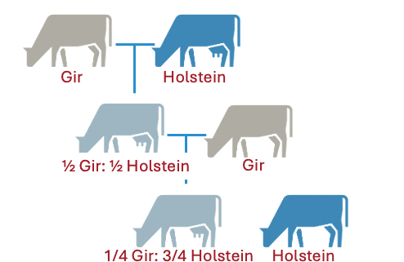
What about a hybrid program?
Benefits
Maintains some heterosis
Occasional introduction of new genetic variation
All animals have the same breed composition
Genetic calculations remain fairly easy
Girolando bull
Girolando cow
Girolando cow
Girolando bull
Etc.

Slide 21
Comparison of strategies
 | Continuous Crossing | Closed Herdbook | Open Herdbook (Hybrid)
Breed type | Mixed crossbreds | Synthetic breed | Synthetic breed
Genetic evaluations | Most complex | Least complex | Somewhat complex
Genetic variation | Greatest variation | Least variation | Moderate variation
Pedigree breed composition | Highly variable | 100% Girolando | 5/8 Gir : 3/8 Holstein
Genomic breed composition | Highly variable | 100% Girolando | Somewhat variable
Rate of genetic gain | Slowest genetic gains | Fastest gains | Moderate gains
Stability of population | Unstable | Very stable | Reasonably stable
Individual heterosis (%) | 33 | 50 | 33-50
Maternal heterosis (%) | 67 | 50 | 50-67
Sullivan (2021; https://futurebeef.com.au/resources/crossbreeding-systems-for-beef-cattle/)

Slide 22
Heterosis in Girolando cattle
Trait | Breed effect (relative to HO) | Heterosis effect (relative to HO) | Heterosis (%)
Age at first calving | −159.80 ± 10.01 | −104.04 ± 5.97 | 10.03
Calving interval 1-2 | −35.61 ± 10.62 | −29.80 ± 6.14 | 6.53
Days open 1-2 | −23.37 ± 6.70 | −12.57±3.86 | 9.56
Dry period 1-2 | −75.52 ± 7.27 | −29.87 ± 4.18 | 21.93
305d milk (parity 1) | 2,165.24 ± 114.09 | 799.03 ± 69.56 | 21.02
305d milk (parity 2) | 2,697.23 ± 156.23 | 897.46 ± 93.95 | 23.23
Lactation length 1 | 42.31 ± 6.14 | 0.15 ± 3.76 | 0.05
Lactation length 2 | 49.73 ± 7.71 | −4.19 ± 4.64 | -1.49
Breeds considered were: Holstein (H), Gir (G), and six Holstein × Gir composites: 1/4H : 3/4G; 3/8H : 5/8G; 1/2H:1/2G; 5/8H:3/8G; 3/4H:1/4G; and 7/8H:1/8G.
Vieira et al. (2022; https://doi.org/10.37496/rbz5120200266)

Slide 23
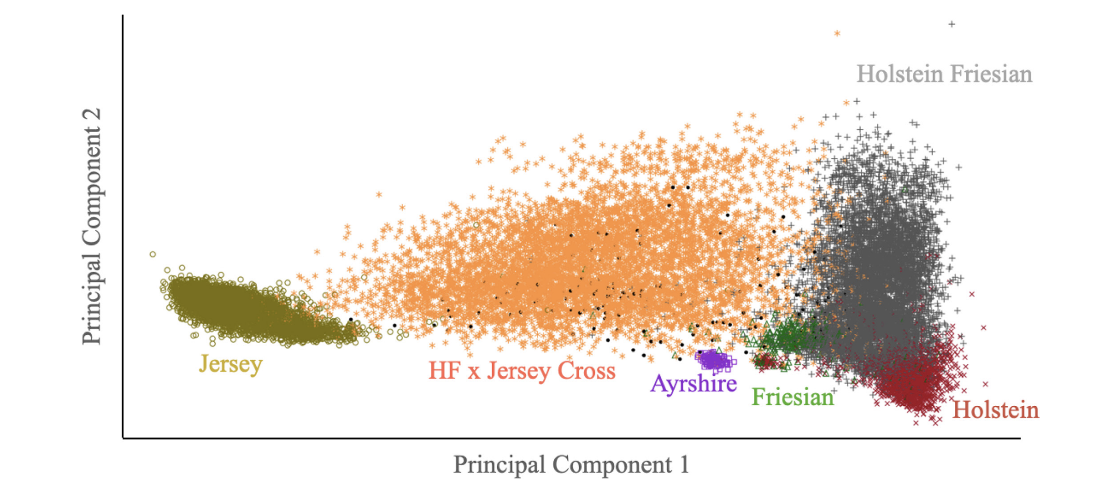
Genotypes show true breed composition
Harris (2022; https://doi.org/10.3168/jdsc.2021-0176)

Slide 24
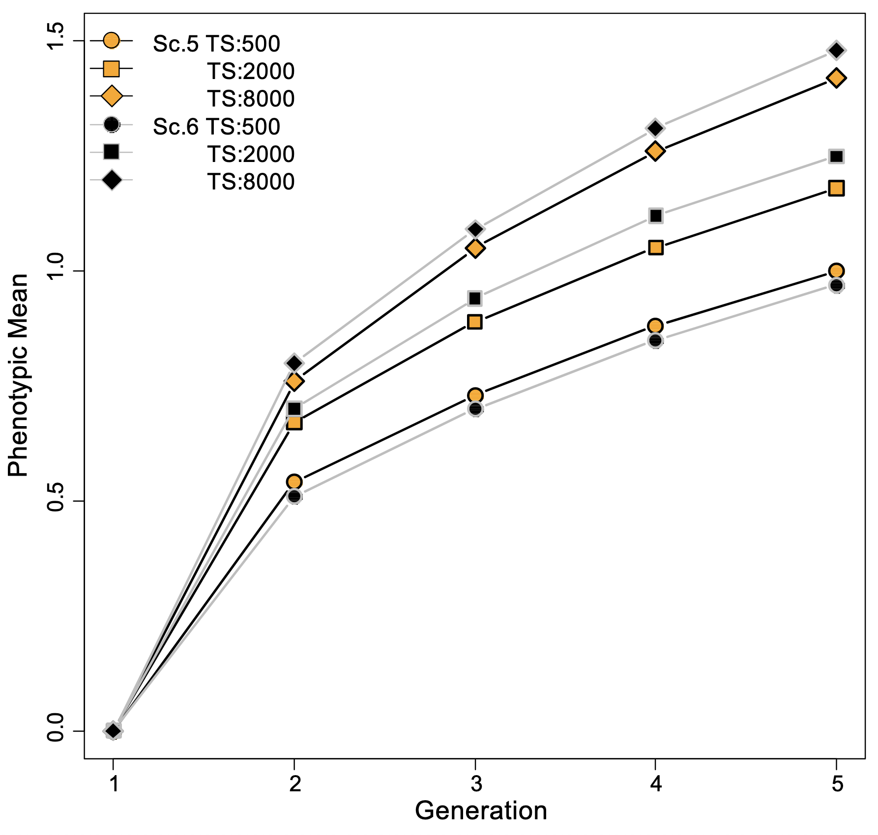
Genomics benefits from a crossbred reference population
The larger the training population the greater the rate of gain
When you can tell alternate heterozygotes apart (Aa and aA) genetic gains are larger
Esfandyari et al. (2015; https://doi.org/10.1186/s12711-015-0155-z)

Slide 25
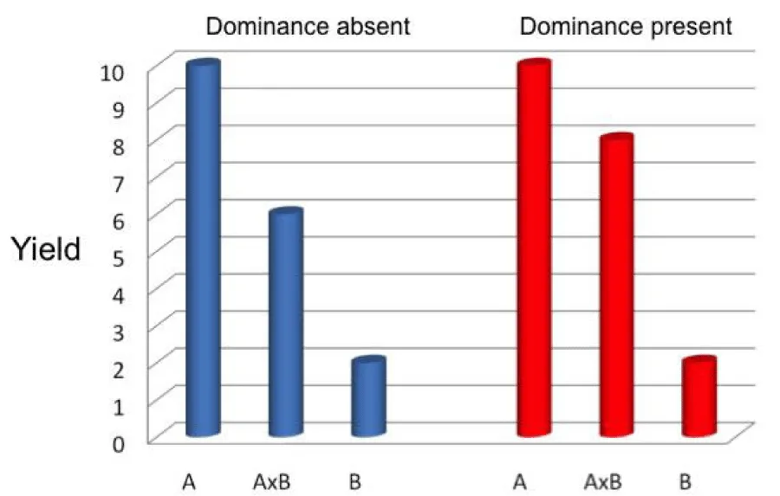
Precision breeding
Combines additive effects with dominance effects unique to a particular pair of animals
A similar strategy is used in swine and poultry breeding
  (They might have taken the idea from plant breeders.)
Begna (2021; https://dx.doi.org/10.17352/ojps.000043)

Slide 26
Matings with specific combining ability
Crossbred Mating 1
Crossbred Mating 2
+50
+30
+50
+30
+40
+40
50 + 1 (2% heterosis for this specific mating) = 51
50 + 10 (20% heterosis for this specific mating) = 60

Slide 27
Closing thoughts
Crossbreeding allows farmers to combine the best features of 2 or more breeds.
There is more variability among animals produced using crossbreeding than purebreeding.
Overall economic merit of crossbreds may be similar even if genetic progress may be slower.
Mating programs can help find the best available cross.

Slide 28

Questions?
Thank you for your
attention!
john.cole@uscdcb.com

